Slide 1

Promoting rural development resilience amid agrifood systems transformation with some implications for China
Christopher B. Barrett
Cornell University
Lecture at Renmin University, Beijing, China
October 29, 2025

Slide 2
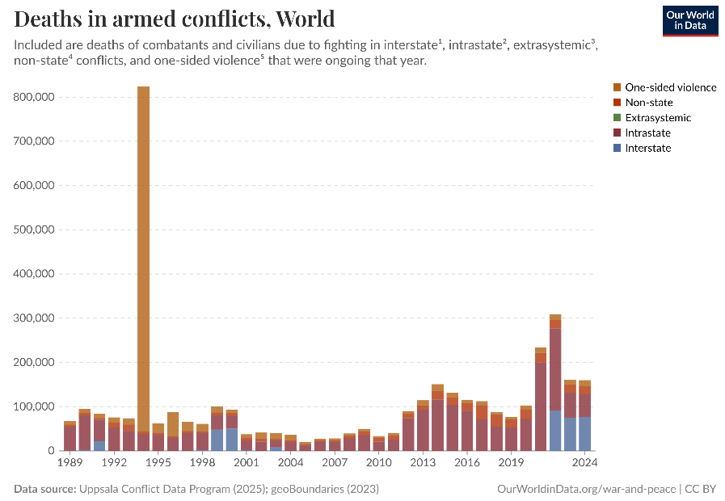
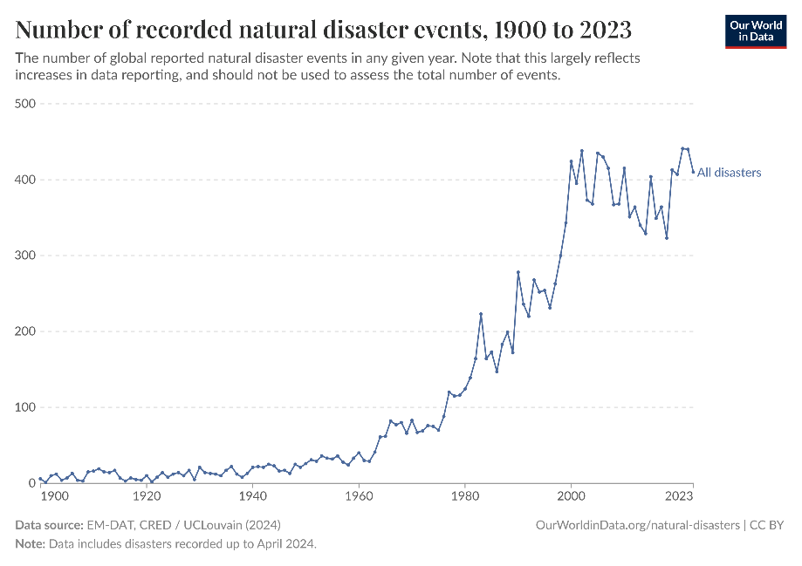
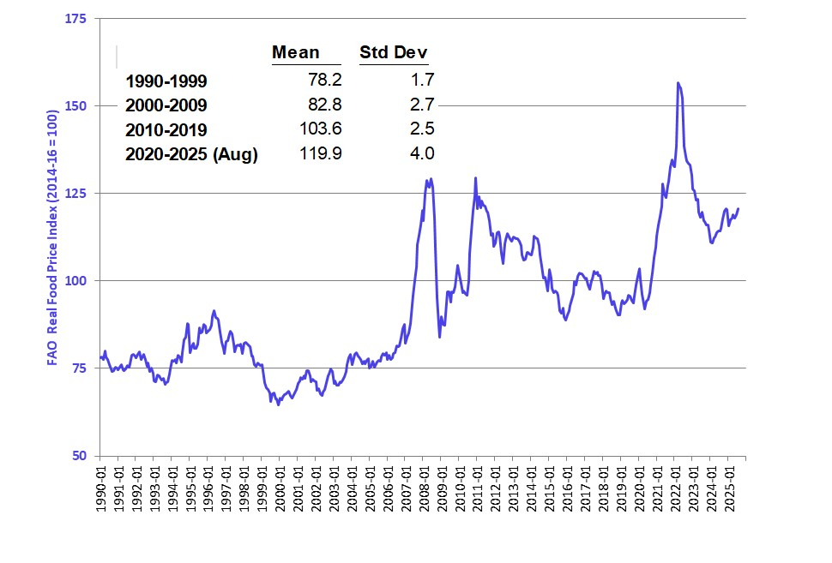
The world grows increasingly risky
The world – and especially low-income, rural communities – face increasing risk of climate/conflict/food price/other shocks.

Slide 3
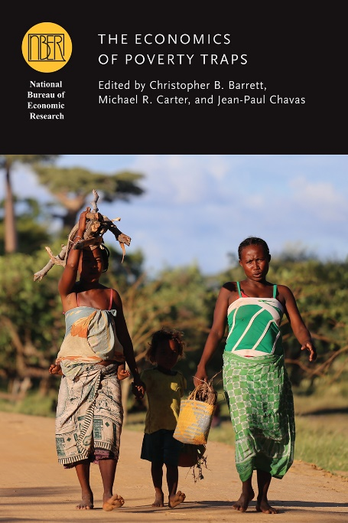
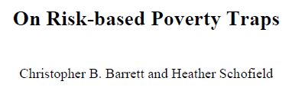

Risk and poverty traps
The poorest places are defined not only by the depth and prevalence of poverty but equally by poverty’s persistence. Persistent poverty signals a trap?
The emergent view of poverty traps emphasizes uninsured risk exposure as a key cause.
The possibility of risk-based poverty traps puts a premium on risk reduction and risk transfer tools and on systems transformation.

Slide 4
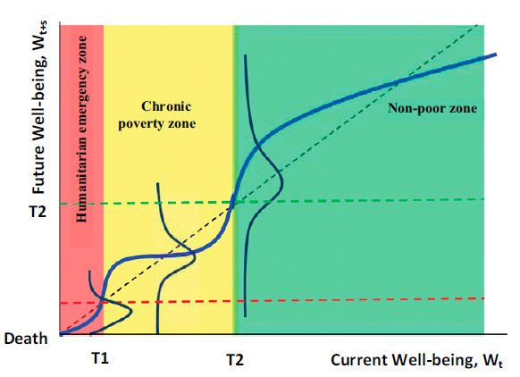

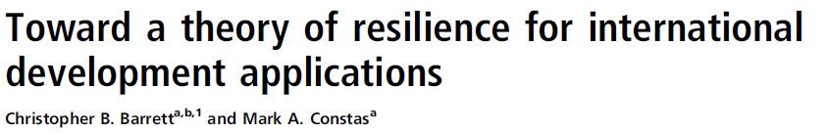
Risk and poverty traps
Development resilience exists when people can absorb or quickly recover from potentially catastrophic shocks and stressors.
Development ambition: move people to / keep them in NPZ and raise steady state level of well-being.
Humanitarian imperative: keep people from falling into HEZ.
poverty line

Slide 5
Risk and poverty traps: programming implications
Policy objective: minimize the duration, intensity and likelihood of people’s experience of poverty. Maximize human flourishing!
Building resilience requires three changes:
Increase W_{t}. Ex: cash transfers, education, land or other assets.
Risk reduction/transfer. Ex: insurance, stress-resistant crop varieties, workfare.
Change system structure. Ex: technologies/institutions/policies (Challenge: multi-scalar reinforcement: ‘fractal poverty traps’ (Barrett & Swallow, World Dev’t 2006)
poverty line

Slide 6
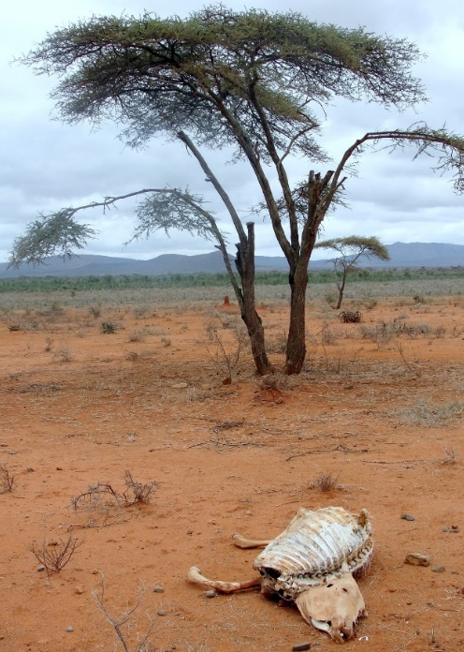
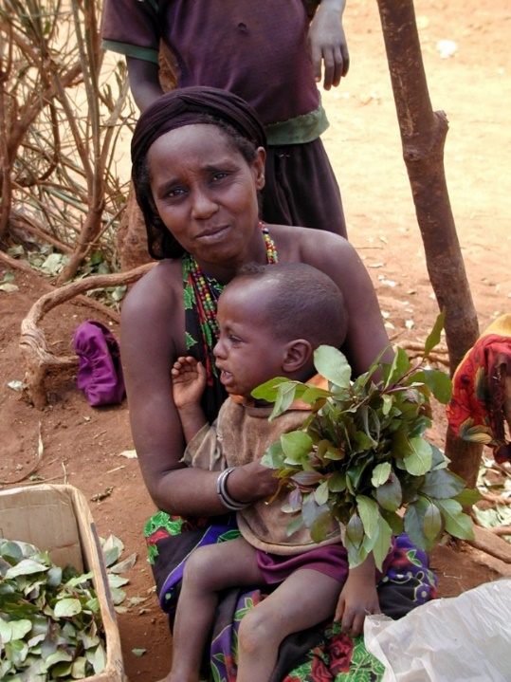
Risk transfer example: Index-based livestock insurance (IBLI)
Poverty traps exist in the arid and semi-arid lands of Kenya/Ethiopia. Catastrophic herd loss risk due to major droughts is the major cause of these dynamics. Puts a premium on drought risk management, both for individuals and for society.
Source: Lybbert et al. (2004 EJ)

Slide 7
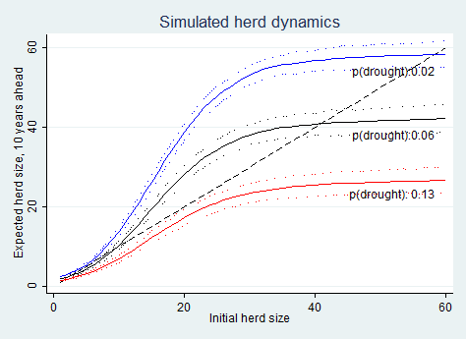
IBLI: The threat of climate change
Drought risk worsening. Pastoralist systems adapted to weather shocks. But is it resilient to a shift in climate? Many models predict increased rainfall variability (i.e., increased risk of drought).
Herd dynamics differ b/n good and poor rainfall states, so change w/drought (<250 mm/yr) risk.
In southern Ethiopia, in expectation, doubling drought risk leads to system collapse in the absence of any change to prevailing herd dynamics.
Need something more than food aid!
Source: Barrett and Santos (Ecol Econ 2014)

Slide 8
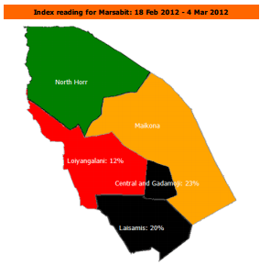

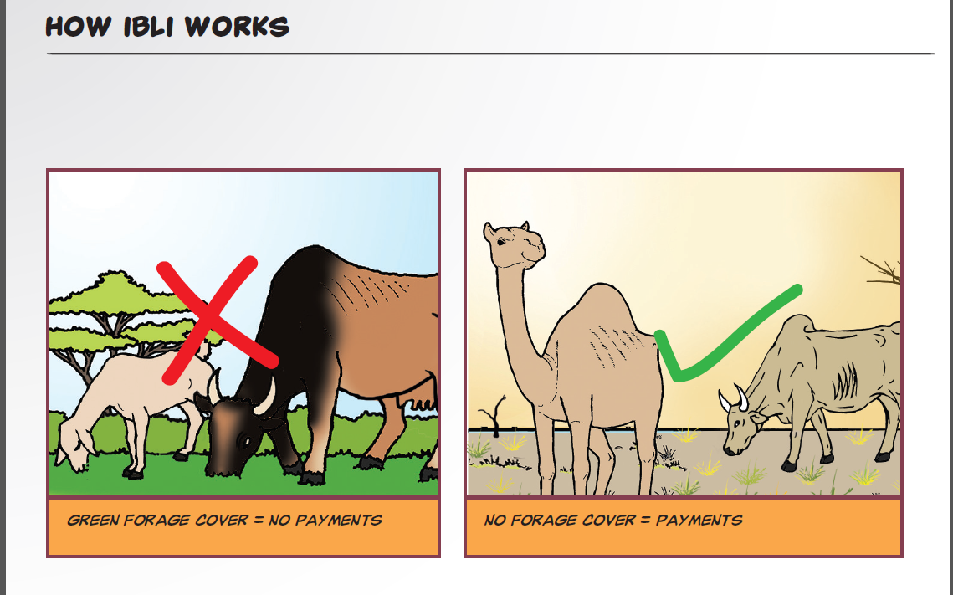
IBLI design and impacts
Use near-real-time Normalized Difference Vegetation Index (NDVI) MODIS satellite data to define losses based on historical NDVI-mortality relationship. For expected losses >15%, seasonal payment from reinsured insurer.
Imperfect product, but worked as designed, with big impacts. Marginal impact on income or MUAC is 6-45x that of cash transfers! 40-55% increase in children’s education! Scaled out to Kenya, Djibouti, Ethiopia, Mauritania, Somalia, Zambia. 3.2 million insured as of summer 2025.
For more, see Jensen et al. book (CUP, 2024), Barrett et al. (2025 working paper)

Slide 9
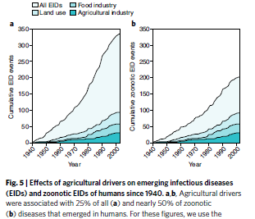
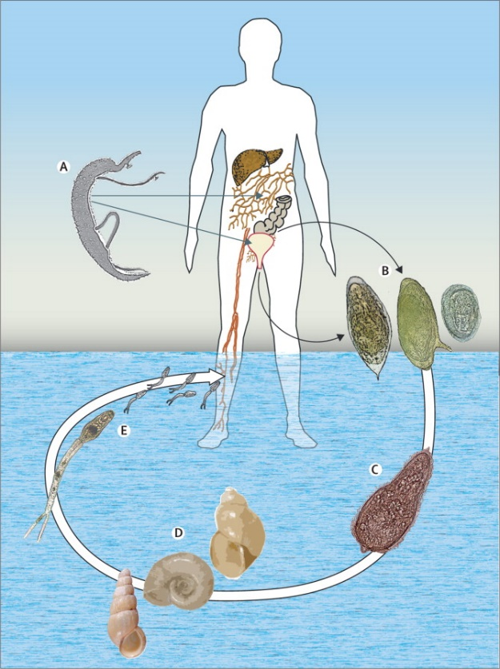
Risk reduction example: Schisto biocontrol in Senegal
Ag dev’t can aggravate infectious disease burdens.
Schistosomiasis affects >240m globally (>800m at risk). China has improved, but human/cattle risk remains.
Great example of a poverty-disease trap. Impedes child cognitive/physical dev’t via anemia, morbidity. Disrupts work/school attendance. Suppresses immunoresponse.
Deworming (MDA of praziquantel) has high reinfection rates. Biocontrols (e.g., prawns) largely ineffective.
Source: Colley et al. The Lancet 2014

Slide 10
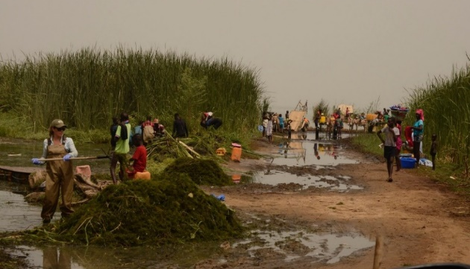
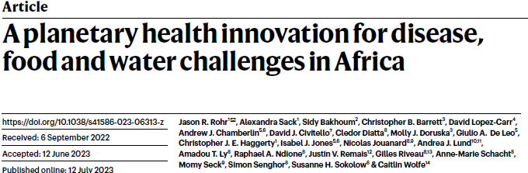
A novel biocontrol method that benefits agriculture
Remedy: clear snails’ preferred habitat: submerged Ceratophyllum demersum.
It works! Snails and infections (esp. S. mansoni) sharply reduced. Use the biomass as compost:
Private B/C =[2.7,4.0]; Public B/C=[3.1,8.8]

Slide 11
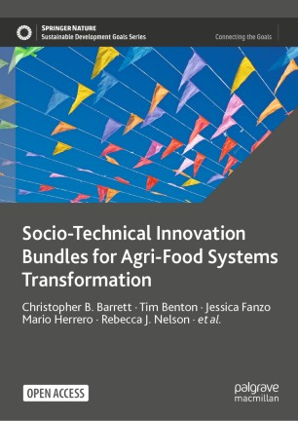
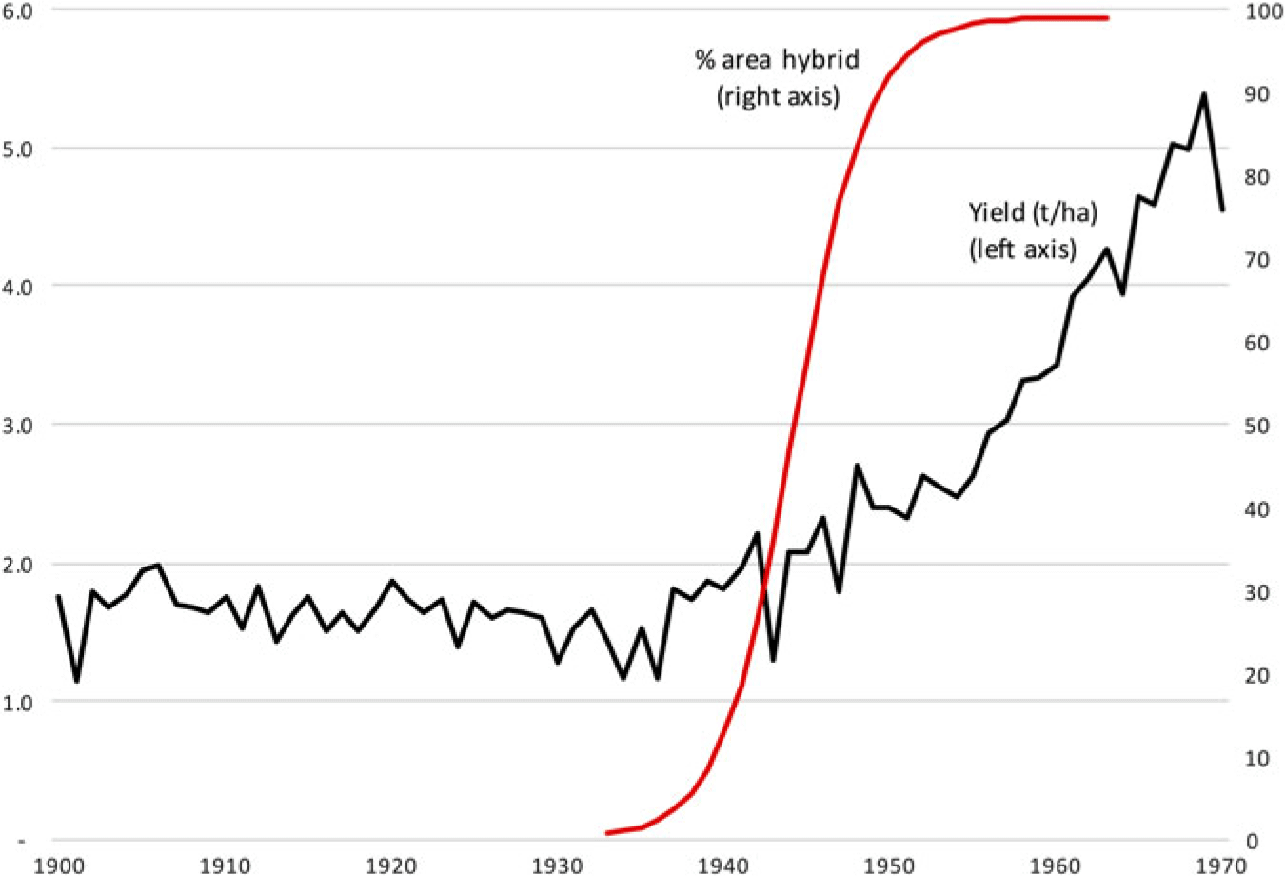
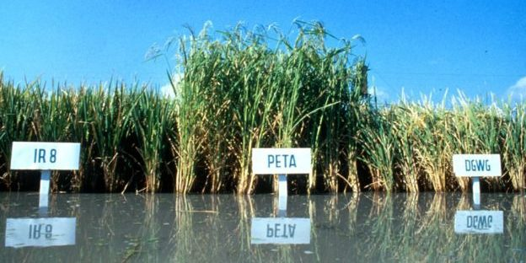
Change agrifood systems structures
Agrifood systems are a common denominator to today’s polycrises.
Building resilience requires AFS transformation.
Hard but feasible. Overcame similar threats in 1930s-60s by bundling socio-technical innovations.
Resurrect that strategy but tailor to current needs.
Source: IRRI
Yield of maize (tons per hectare) and percentage area sown to hybrid seed, USA, 1900–70. Source: Byerlee (2020)

Slide 12
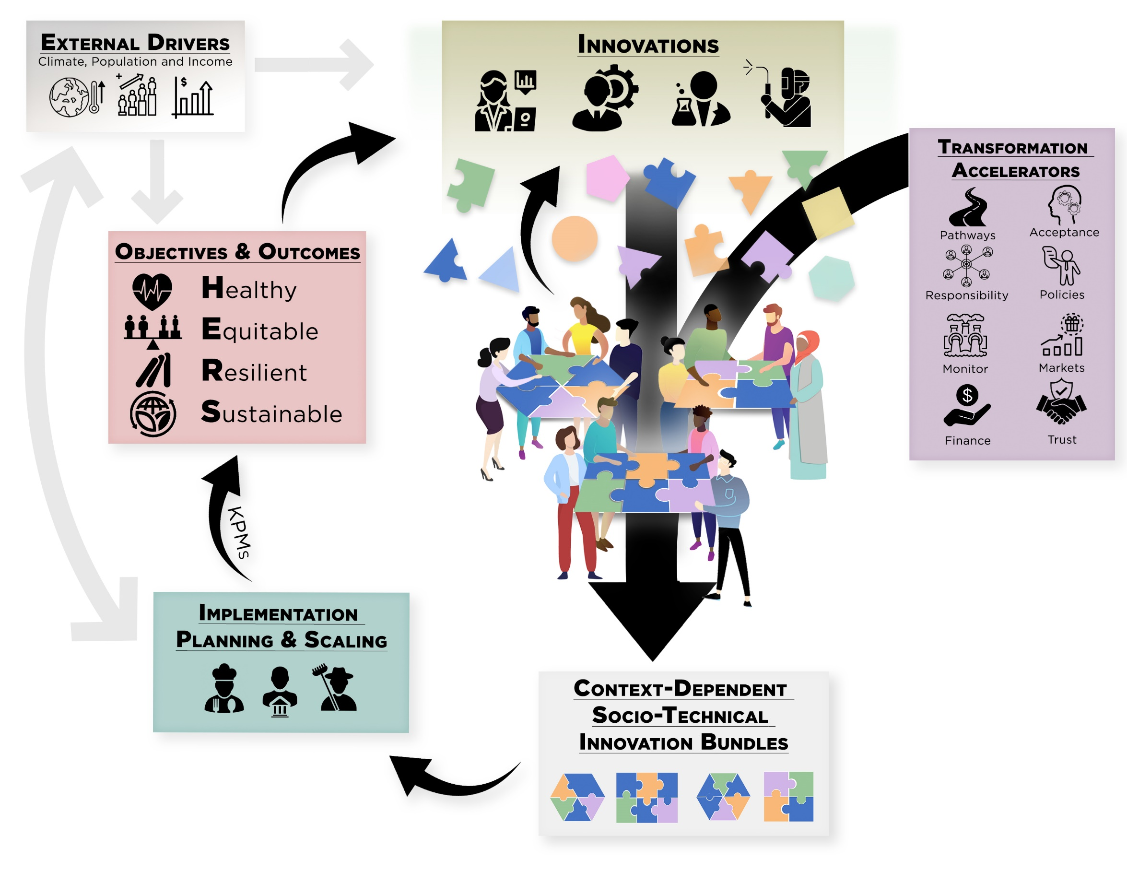
Define objectives correctly for AFS transformation
Priorities no longer need increasing yields / calorie availability.
Need sustainable, resilient TFP growth and induced demand shifts
to build healthy, equitable, resilient and sustainable AFS.

Slide 13
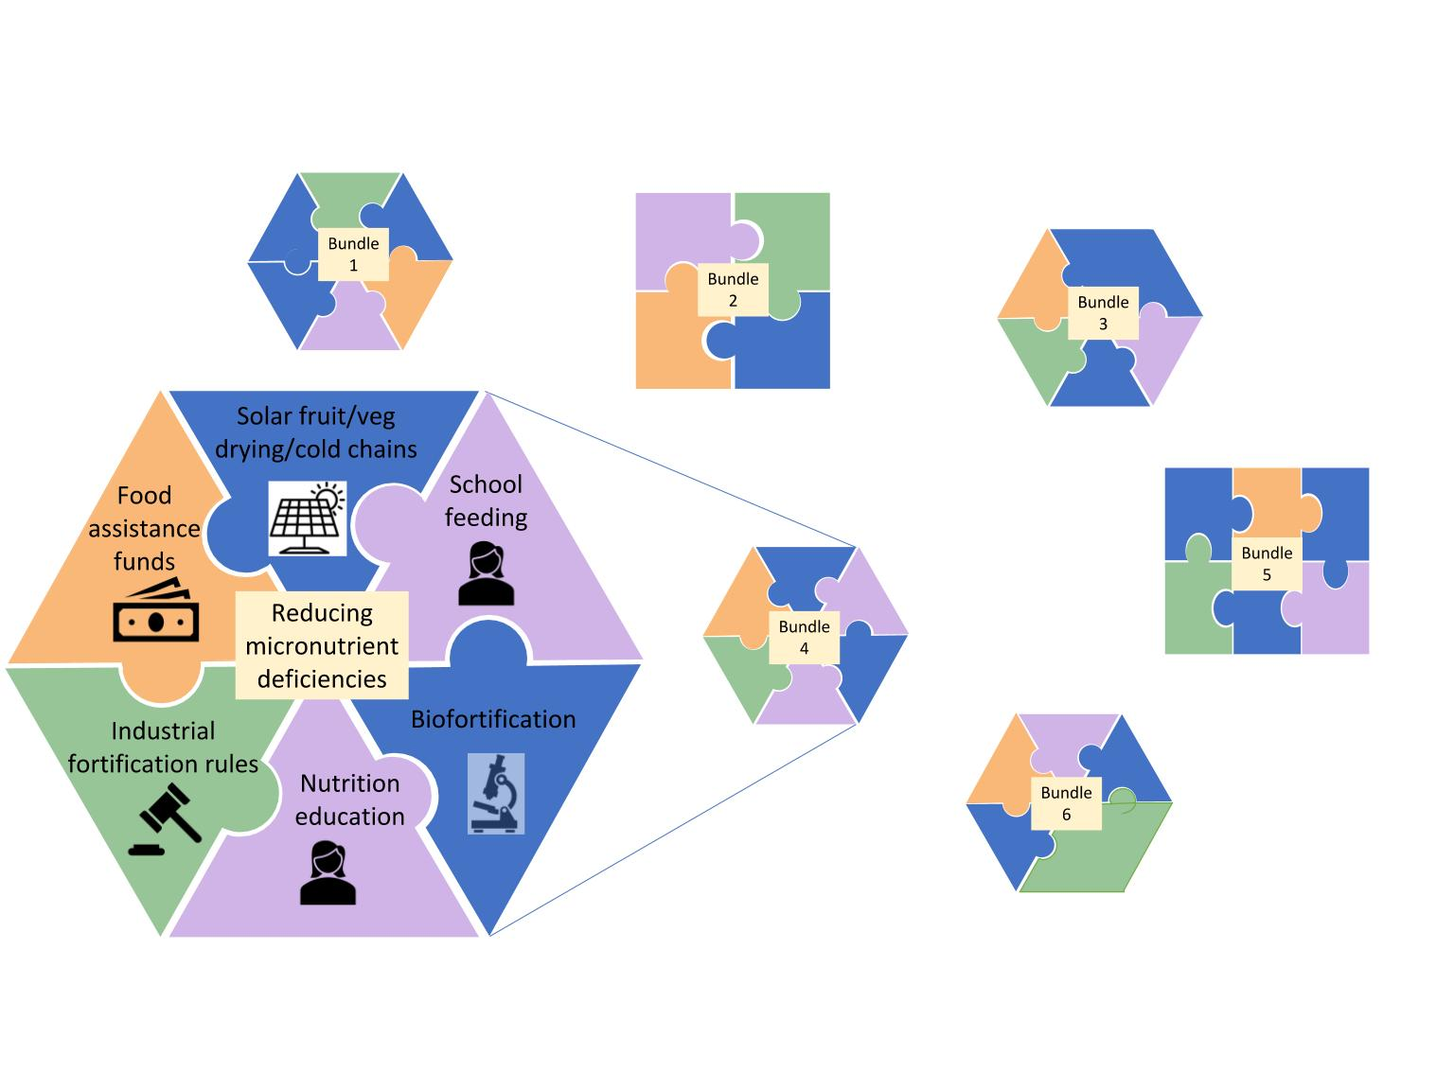
Key steps in AFS transformation
Co-create context-appropriate bundles of socio-technical innovations. With climate change need accelerated feedback.
(Science & Technology Backyards may be a global model!)
- Solutions are never just technical
- Populations are never homogeneous
- Political economy requires coalition building, esp. to address the ‘creative destruction’ intrinsic to innovation.
Think in terms of bundles, not magic bullets.

Slide 14
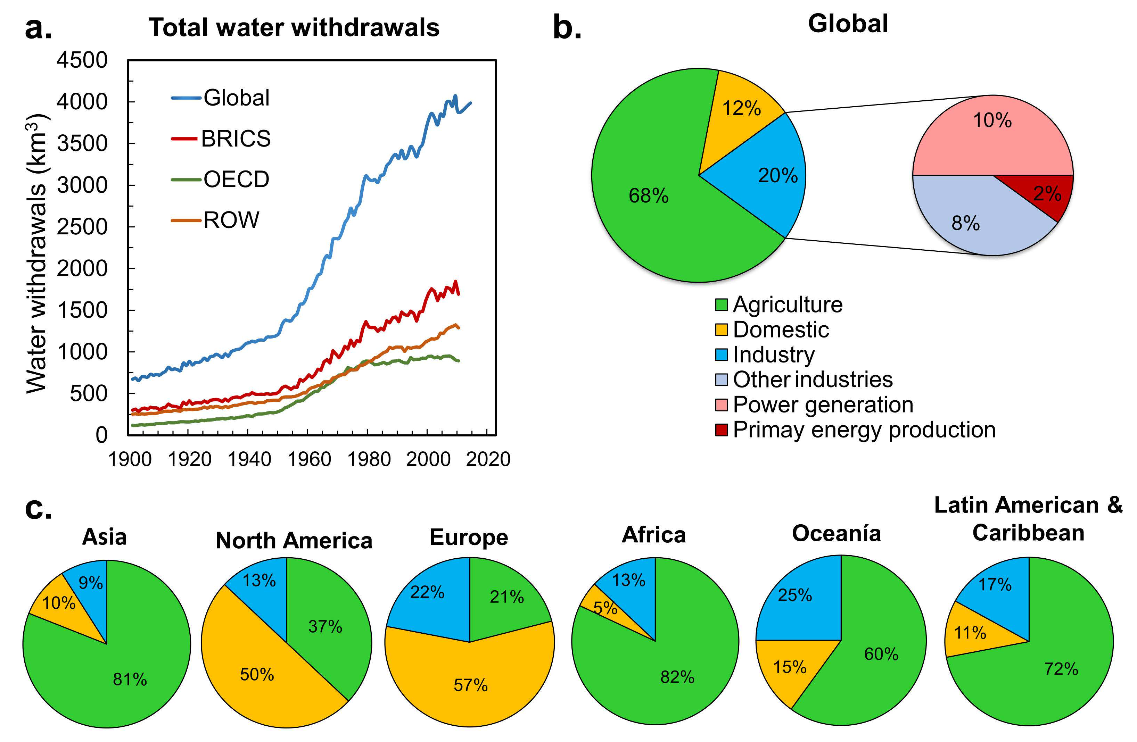
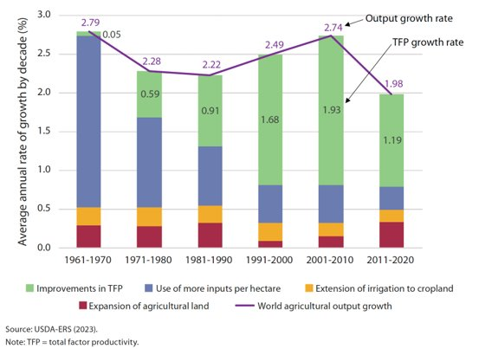
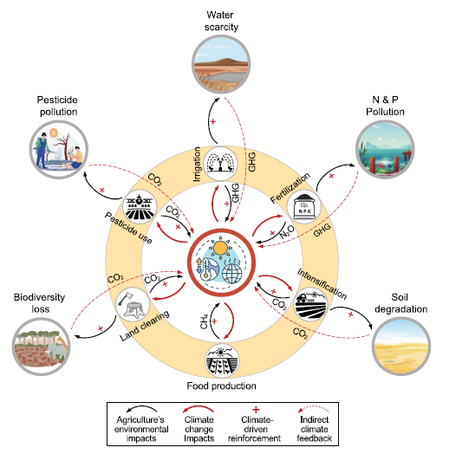
Key steps in AFS transformation
2. Reduce food’s land and water (and chemical) footprint
Especially with climate change, agrifood systems imperil planetary boundaries.
Since 1990s, global ag ouput growth largely been driven by productivity growth. But productivity growth has slowed considerably in recent years.
Source: Singh & Su IJSC 2022
Source: Yang et al. (Science 2024)

Slide 15
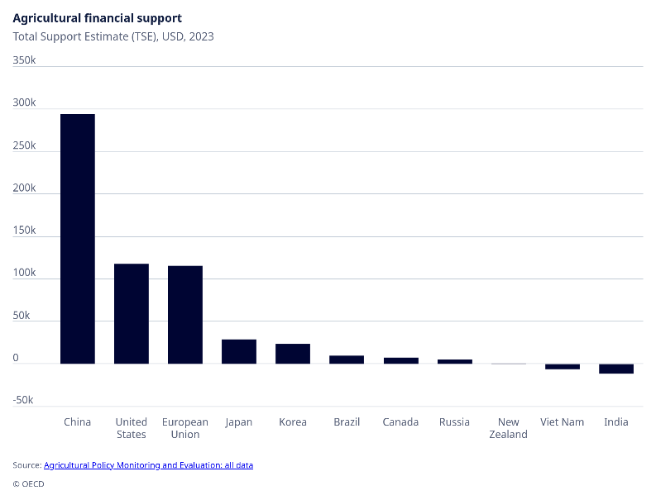
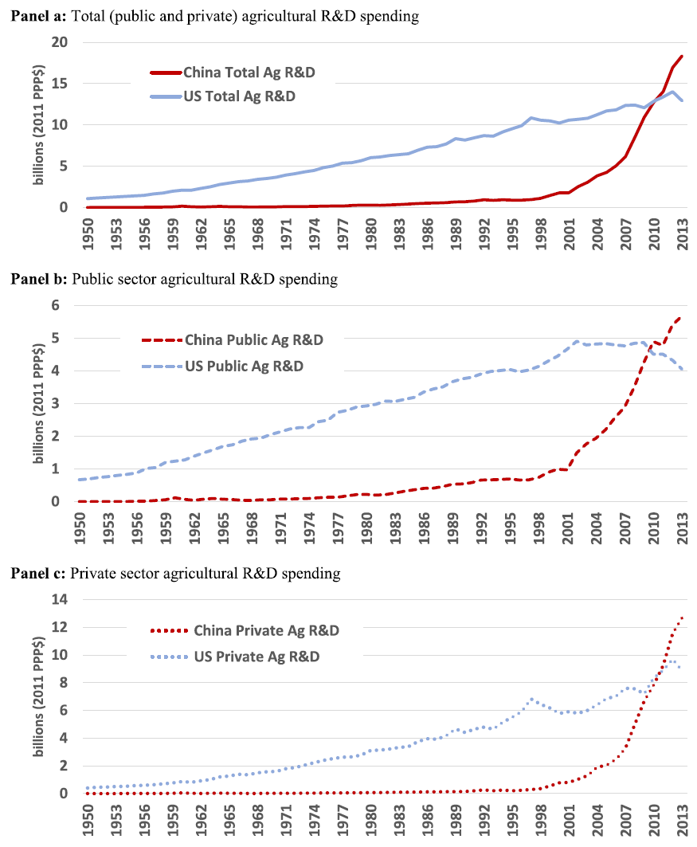
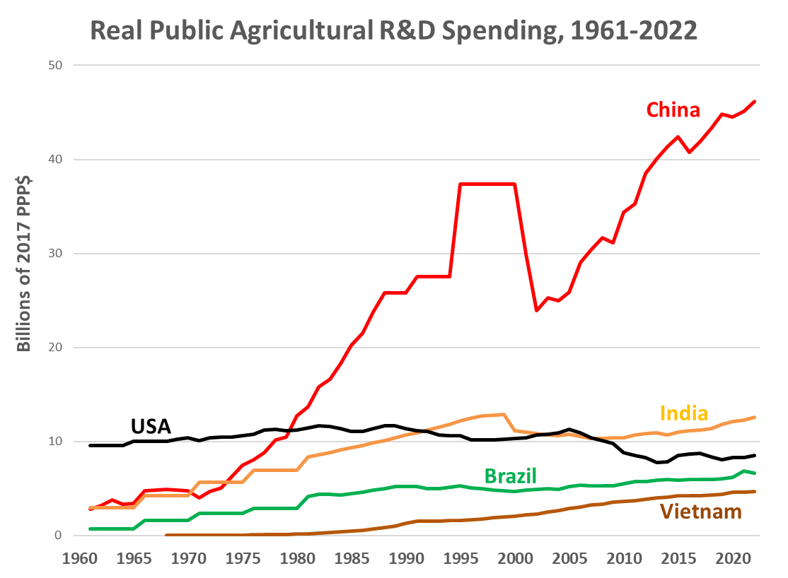
Key steps in AFS transformation
3. More public R&D, less direct producer support ($2 bn/day!)
The slowdown in agricultural productivity growth is associated with a slowdown in R&D investment. When China has to pull back, maintain R&D!
Data source: GRAPE, van Dijk et al. (SD 2025)
Source: Chai et al. (Food Policy 2019)

Slide 16
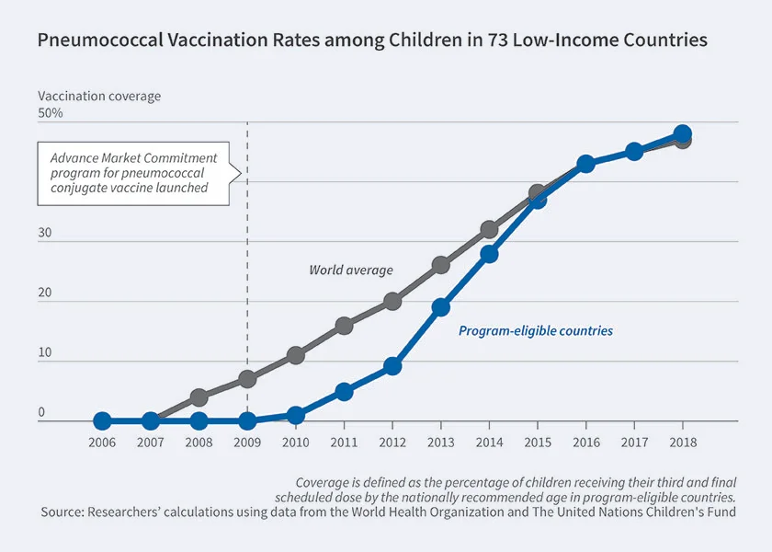
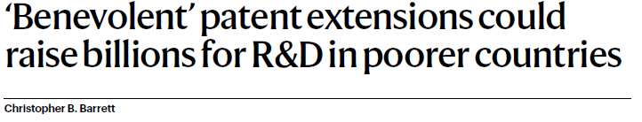
Key steps in AFS transformation
4. Public and philanthropic funding declining. Requires new models to attract private R&D investment in AFS innovation.
Advance Market Commitments Pre-commit to purchase adequate volume to make it profitable. Used effectively for vaccine development.
Benevolent patent extensions A new idea to tap high income consumer demand for patented luxuries to finance R&D for the poor.
Source: Barrett (Nature 2023)
Source: Kremer et al. (NBER 2020)

Slide 17
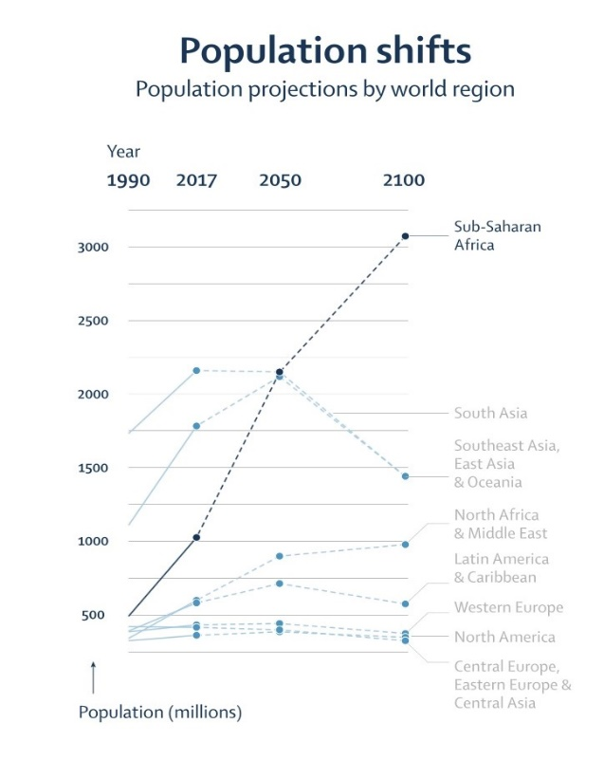
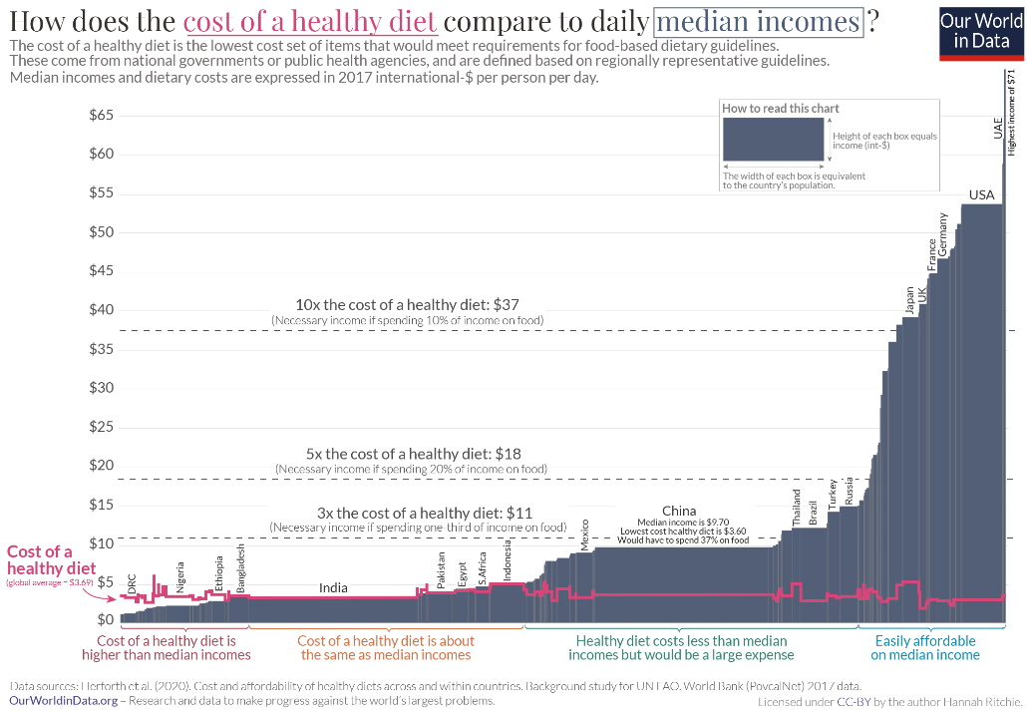
Key steps in AFS transformation
5. Food demand growth to 2100 ~all in Africa/Asia. Most acute affordability, biodiversity, water, zoonoses issues are there too. Technology mismatches are large (Moscona & Sastry 2025 papers).
Source: Vollset et al. 2020
Freshwater withdrawals
Source: Singh & Su IJSC 2022

Slide 18
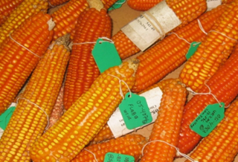
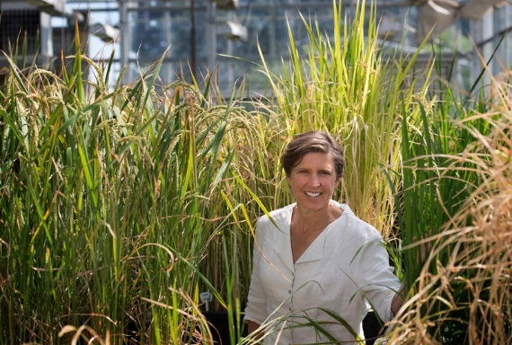
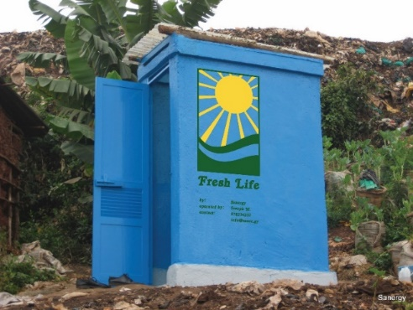
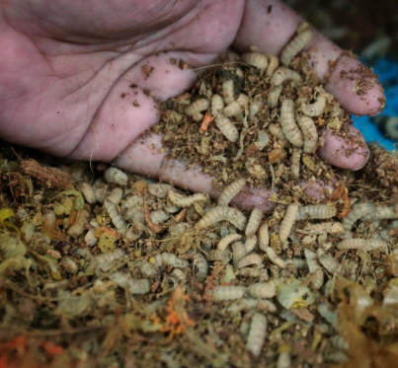
Good news: Many agricultural innovations on the way!
Agricultural innovations:
- Biofortified crops boost micronutrient access
- Crops resist flooding, drought, heat, pest stress
- Livestock feeds reduce methane emissions
- Upcycling wastes for fertilizer/feeds
New genomic techniques and digital tools raise likelihood and accelerate rate of breakthroughs!
Photo credits: Genetic Literacy Project, Mike Gore, Alexander Mathys, Sanergy, Andrew Simons

Slide 19
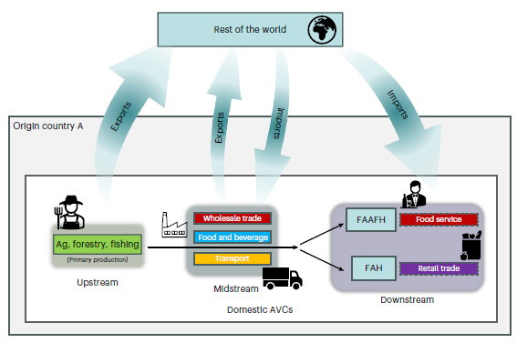
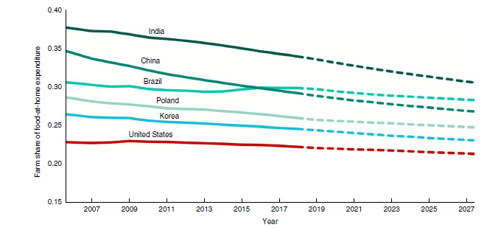
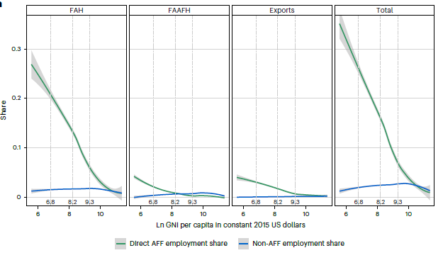
Promising post-farmgate innovations equally important
As incomes rise, value addition and jobs steadily move downstream as consumers seek convenience, quality, safety and variety.
Sources: Yi et al. (Nature Food 2021, 2025)
So need rural infrastructure to absorb inter-sectoral labor migration to better jobs post-farmgate.

Slide 20
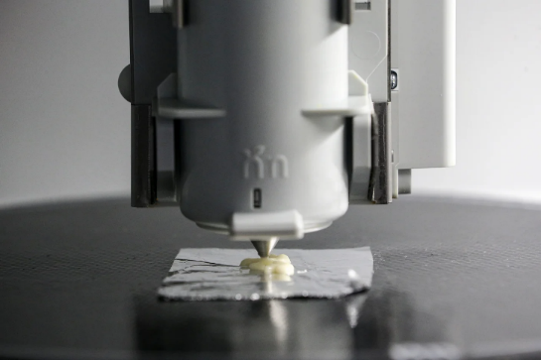
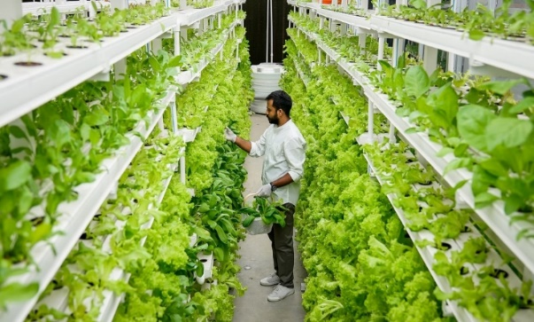
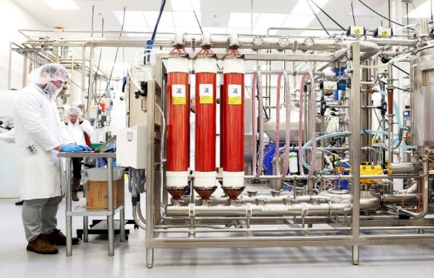
Promising post-farmgate options equally important
Decoupling food production from land is increasingly culturally, economically, technologically feasible. Crucial for climate, infectious disease control, healthier/safer fresh, perishable foods.
Photo credits: Wallace Woon (Straits Times), Betterindia.com, Beck Deifenbach/ Reuters
Photo: Betterindia.com
Photo: Beck Deifenbach/Reuters
May be easier to induce change mid-value chain than among farmers or consumers. Profit-seeking, risk- reducing, non-farm companies can drive change w/regulatory oversight and stakeholder pressure.
Especially fast for ingredients! Learn the lesson of rennet.

Slide 21
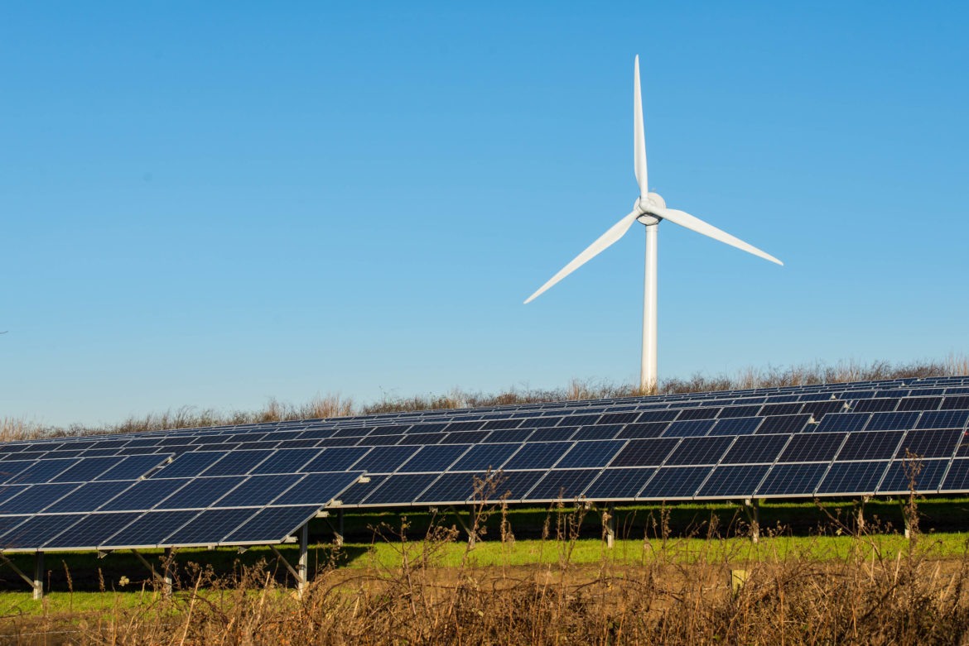
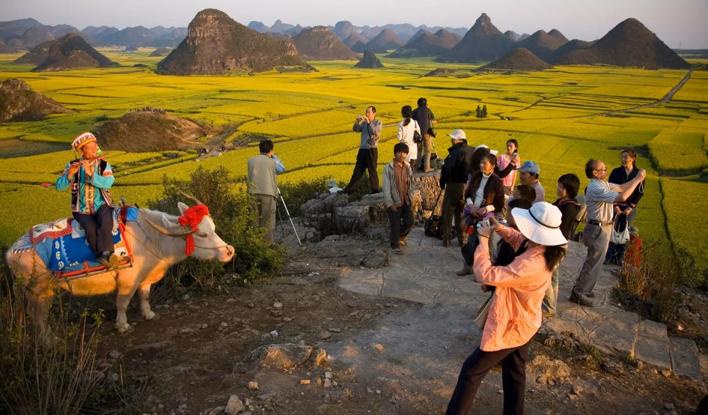
Must facilitate rural livelihoods transitions
Employment in agriculture falls steadily as economies develop.
Rural areas need new income sources. Rather than farming crops and livestock, farm carbon, solar, wind and wildlife!
Renewable energy generation
Post-harvest food/feed/fuel processing and manufacturing (which benefit from more, cheaper renewable energy generation)
Environmental services (carbon credits, water purification, habitat)
Recreation and tourism

Slide 22
Key takeaways
Humanity can build resilience to shocks, even in low-income rural communities. China is well positioned to lead the way.
Requires renewed commitment to innovation bundles (technologies, institutions, policies) to reduce and transfer risk and to transform (esp. AFS) systems, esp. in Africa/Asia.
AFS transformation requires
- shifting focus from calories/yields to HERS indicators
- large growth in AFS R&D, much of it from private sector
- more attention to post-farmgate value chain, incl. off-farm food production
- facilitating rural non-farm livelihoods transitions
Notes:
22

Slide 23
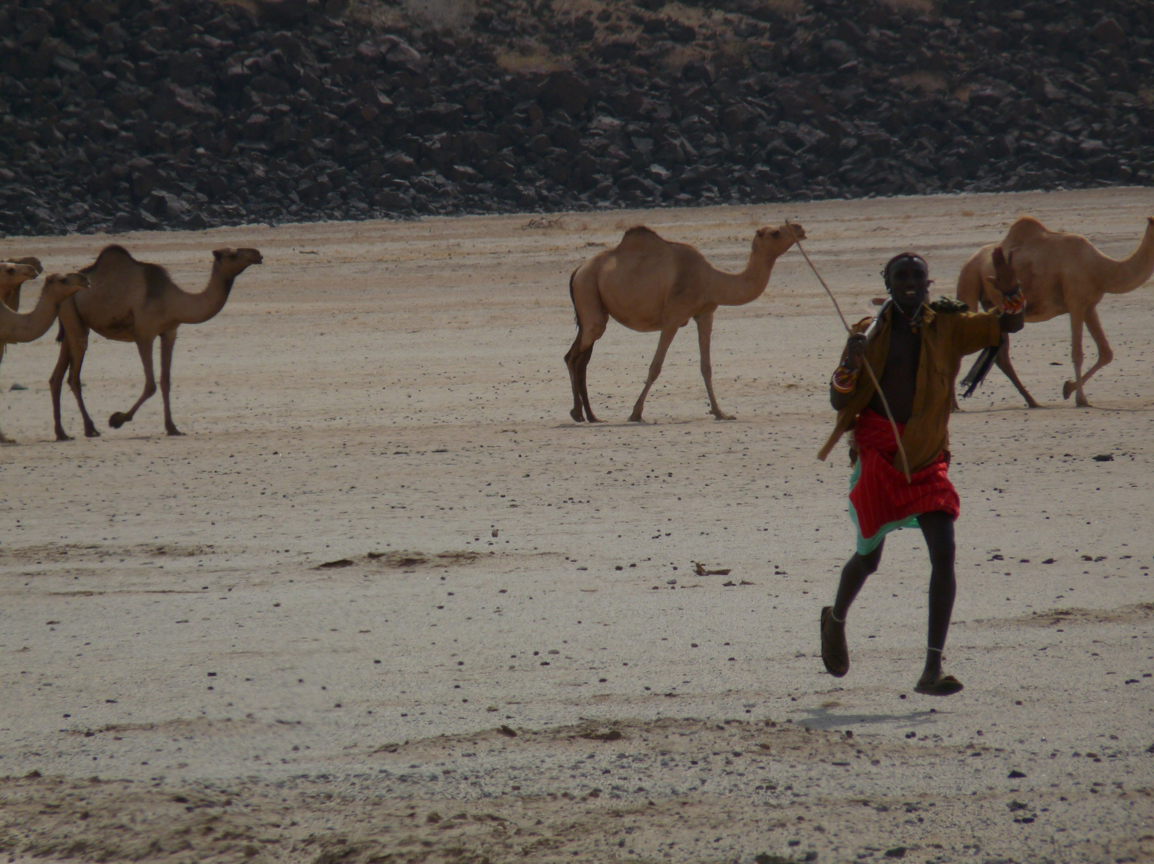
Thank you for your time, interest and comments!
Links to my papers at
https://barrett.dyson.cornell.edu/
Or email me at chris.barrett@cornell.edu
Notes:
23

